Slide 1
Introduction to Machine Learning
Amit Sethi, faculty, IIT Bombay
Sudhakar Kumar, student, IIT Bombay
Rishav Arjun, student, IIT Bombay
SHALA2020.GITHUB.IO
2020.04.24 :: 21:00 UTC+5:30

Slide 2
Learning objectives
Define machine learning
Distinguish between suitable and unsuitable problems for ML
Classify ML problems into supervised and unsupervised
Classify supervised ML problems into classification, regression, and others
Write the difference between metric, loss, parameter, and hyperparameter
Draw a basic picture that identifies underfitting and overfitting
Write steps for hyper-parameter tuning

Slide 3
What is Machine Learning ?
The practice of developing algorithms that use data to discover a/an …
Algorithms, or
Models
Examples of bad and good problems for ML:
Bad : Prediction model is well known, Too little data
Good : Prediction model is not well known, Lots of data

Slide 4
Learning is improving task performance based on experience
Example: Learning to ride a bicycle
T: Task of learning to ride a bicycle
P: Performance of balancing while moving
E: Experience of riding in many situations
Steps for framing a machine learning problem
Identify inputs
Identify desired outputs
Map problem to broad machine learning paradigms
Identify performance criteria

Slide 5
Relation of ML to other fields
Artificial Intelligence
Machine Learning
Neural Networks
Deep Learning

Slide 6

Relation of ML to other fields
Probability and Statistics
Machine Learning
Optimization
Data Science
Linear Algebra

Slide 7
Type of ML problems
Supervised learning: uses labeled data
Classification: Labels are discrete
Regression: Labels are continuous
Ranking: Labels are ordinal
Unsupervised learning: uses unlabeled data
Clustering: Divide data into discrete groups
Dimension reduction: Represent data with fewer numbers
Somewhere in between: fewer labels than one per example
Semi-supervised learning: some examples are labeled
Weakly supervised learning: groups of examples are labeled
Reinforcement learning: Label (reward) is available after a sequence of steps

Slide 8
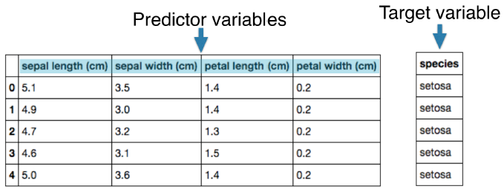
Supervised Learning
Predictor variables/features and a target variable (label)
Aim: Predict the target variable (label), given the predictor variables
Classification: Target variable (y) consists of categories
Regression: Target variable is continuous
(Label)

Slide 9
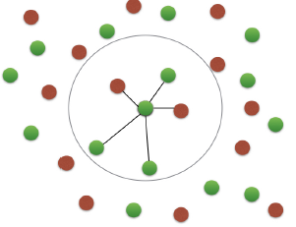
k-Nearest Neighbors
Basic idea: Predict the label of a data point by
Looking at the ‘k’ closest labeled data points
Taking a majority vote
Works for both classification and regression

Slide 10
Packages in Python
We can use scikit-learn/sklearn. It Integrates well with the SciPy stack.
Other libraries are TensorFlow and keras (mainly for neural networks and deep learning).

Slide 11
Parameters and Hyperparameters
Key Concept
Parameters: These are the variable whose values are updated during the training process of model.
Feature coefficient in regression model
Weights of a neural network
Hyperparameters: These are the variables/ parameter whose values are fixed by model developer before the beginning of learning process.
Number of variables in a tree node
Height of a tree
Number of layers of a neural network

Slide 12
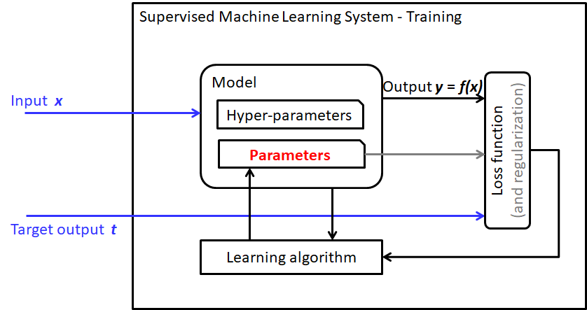
A simplified view of supervised learning

Slide 13
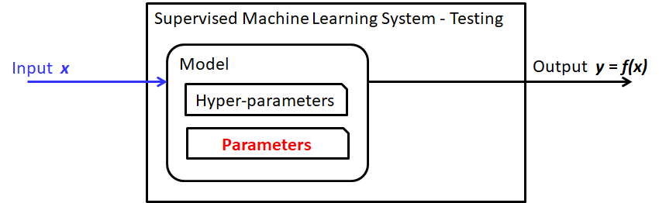
A trained model during testing (deployment)

Slide 14
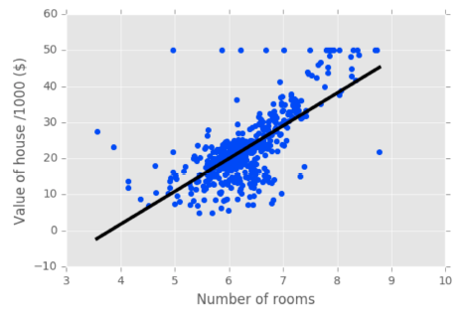
Regression
(this is y or t)
y_{i} = f_{𝛳}(x) = ax_{i} + b
y_{i} = output
t_{i} = target (label)
x_{i} = single feature
a, b = parameters of model (𝛳)
Slope changes with a, y-intercept changes with b (bias)
How do we choose a and b? This is supervised learning problem
Define an loss function and choose a line that minimizes that loss function
We will use this loss function to update our model weights
Loss: Sum of squared errors ∑_{i} (y_{i} - t_{i})². The best fit line minimizes this term.
(this is x)

Slide 15
Regression
In higher dimensions, we must specify coefficient for each feature, and the bias.
y = a₁x₁ + a₂x₂ + a₃x₃ + ... + a_{n}x_{n} + b

Slide 16
Regression
In higher dimensions, we must specify coefficient for each feature, and the bias.
y = a₁x₁ + a₂x₂ + a₃x₃ + ... + a_{n}x_{n} + b
Hyperparameter:
Should we include x_{i}^{p} terms?
What about product terms x_{i}^{p}x_{j}^{q}?

Slide 17
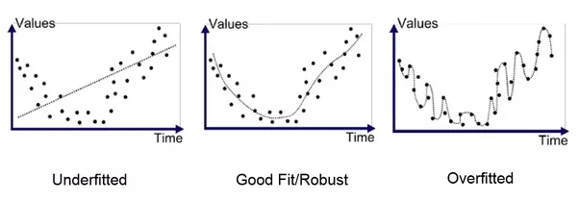
Regularized regression
Key Concept
Informal definition: Restrict the model from becoming too wild such that it over-fits
Optimization minimizes a loss function
For example, it finds an optimal coefficient for each variable that leads to minimum loss
Large coefficients can lead to overfitting
Penalizing large coefficients: Regularization
Original image source unknown

Slide 18


Ridge Regression
Loss function = OLS loss function +
Alpha is a hyperparameter and it controls model complexity
Alpha = 0: We get back OLS (Can lead to over-fitting)
Lasso Regression
Loss function = OLS loss function +
Can be used to select important features of a dataset
Shrinks the coefficients of less important features very close to 0

Slide 19
Types of dataset
Key Concept
Training data: The sample of data used to fit the model
Validation data: The sample of data used to provide an unbiased evaluation of a model fit on the training dataset while tuning model hyperparameters.
Testing data: The sample of data used to provide an unbiased evaluation of the final model.
Validation data should be representative of test situation (deployment). Otherwise, you are fooling yourself !!
Generally, we split data into training and testing (80/20 is indeed a good starting point). After that we can split the training data further into training and validation (again, 80/20 is a fair split).

Slide 20
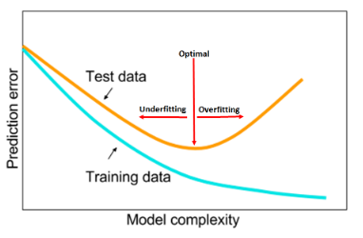

Model Fit: Underfitting vs. Overfitting
Key Concept
Underfitting: When the model performs poorly on the training data.
Overfitting: When model perform well on the training data but but does not perform well on the evaluation data.
Loss Function:
← more regularized less regularized →
Validation data
Image sources:
https://media.arxiv-vanity.com/render-output/2177140/under-overfitting.png

Slide 21
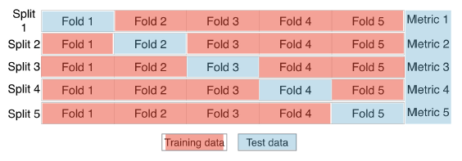
Cross-validation
Model performance measurement is dependent on way the data is split
Not representative of the model’s ability to generalize
Solution: Cross-validation, especially when data is less

Slide 22
Cross-validation
k folds = k-fold CV
More folds = More computationally expensive
Final metric would be the average of all k metrics value.

Slide 23
Bias-variance trade-off
Generalization of model is bounded by the two undesirable outcomes high bias and high variance.
Underfitting: High bias, Low variance
Overfitting: Low bias, High variance
Bias occurs when an algorithm has limited flexibility to learn the true signal from the dataset. High bias can cause an algorithm to miss the relevant relations between features and target outputs (underfitting).
Variance is an error from sensitivity to small fluctuations in the training set. High variance can cause an algorithm to model the random noise in the training data, rather than the intended outputs (overfitting).

Slide 24
Loss versus performance metric
Loss is a convenient expression used for guiding the learning (optimization)
Loss is related to performance metric, but it is not the same
Loss also includes regularization
Performance metric is what is used to judge the model
Performance metric on only the held-out (validation or test) data makes sense

Slide 25
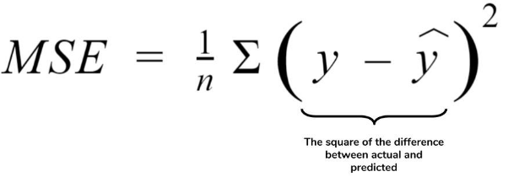
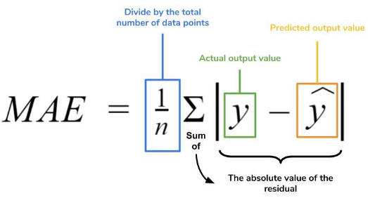
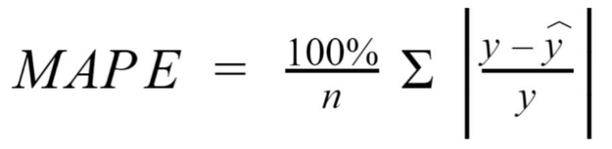
Measuring model performance
Regression Metrics
https://www.dataquest.io/blog/understanding-regression-error-metrics/

Slide 26
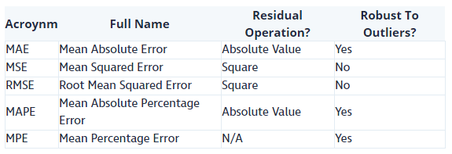
The effect of the square term in the MSE equation is most apparent with the presence of outliers in our data. Model will be penalized more for making predictions that differ greatly from the corresponding actual value.
The RMSE is analogous to the standard deviation (MSE to variance) and is a measure of how large your residuals are spread out.
MAPE has a clear interpretation since percentages are easier for people to conceptualize. But it’s undefined for data points where the value is 0.

Slide 27
2. Classification Metrics
Accuracy is a commonly used metric. It is fraction of correct predictions
But it is not always a useful metric. For example in spam classification problem 99% of emails are real; 1% of emails are spam. We could build a model that predicts all emails as real and still it is 99% accurate !
Other metrics can be
Precision
Recall
ROC (Receiver operating characteristic)

Slide 28
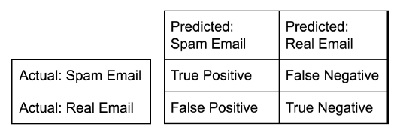

Confusion matrix
It is a specific table layout that allows visualization of the performance of an algorithm, typically a supervised learning one.
Accuracy is defined as

Slide 29
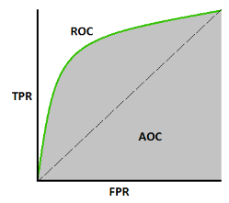





Precision =
Recall =
High precision: Not many real emails predicted as spam
High recall: Predicted most spam emails correctly
ROC curve: The ROC curve is plotted with True Positive rate (TPR) against the FPR where TPR is on y-axis and FPR is on the x-axis.
AUROC curve: AUC tells how much model is capable of distinguishing between classes. Higher the AUC, better the model is at predicting 0s as 0s and 1s as 1s. An excellent model has AUC near to the 1.
https://towardsdatascience.com/understanding-auc-roc-curve-68b2303cc9c5
Notes:
Yet to complete !!

Slide 30
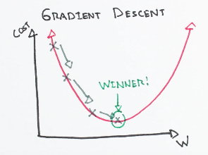
Parameter optimization (weight update)
Gradient descent: It is an optimization algorithm used to minimize some function by iteratively moving in the direction of steepest descent as defined by the negative of the gradient.
In machine learning, we use gradient descent to update the parameters of our model. Parameters refer to coefficients in Linear Regression.
https://ml-cheatsheet.readthedocs.io/en/latest/gradient_descent.html

Slide 31

Parameter optimization (weight update)
Learning rate: The size of these steps is called the learning rate. A low learning rate is desirable, but it requires more computation power.
Cost function ( L ): A Loss Functions tells us “how good” our model is at making predictions for a given set of parameters. The cost function has its own curve and its own gradients.

Slide 32
Unsupervised learning
Unsupervised learning finds patterns in data but without a specific prediction task in mind
For example, clustering customers by their purchases
Represent 50 genes by just two numbers (dimension reduction)

Slide 33
Feature normalization
It is a technique to standardize the independent features present in the data in a fixed range. It is performed during the data pre-processing to handle highly varying magnitudes or values or units.
If feature scaling is not done, then a machine learning algorithm tends to weigh greater values, higher and consider smaller values as the lower values, regardless of the unit of the values.
Source: https://www.geeksforgeeks.org/ml-feature-scaling-part-2/

Slide 34
Techniques to perform Feature Scaling
Min-Max Normalization: This technique re-scales a feature or observation value with distribution value between 0 and 1.
Standardization: It is a very effective technique which re-scales a feature value so that it has distribution with 0 mean value and variance equals to 1.

